Slide 1


Weekly Fantasy Football with Genetic Algorithms
by Greg Filla
Repository: https://github.com/gfilla/Genetic_Algorithms_Football

Slide 2



What did I do?
Weekly fantasy football
  Pick new teams each week
  Lots of data
Genetic Algorithm (GA) to optimize points
  Knapsack problem
  R Implementation of Algorithm
    Genalg Package

Slide 3


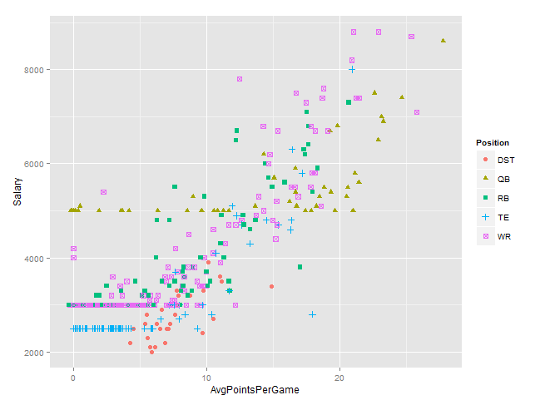
Data Sources
ESPN Projected Points
  Python – pandas read html
NFL Projected Points
  Manually visit website
Draft Kings Salary Data
  CSV with salaries for players
Fantasy Research
  Manually read analyst reports

Slide 4
GA Parameters
Fitness Function
  Salary cap - $50,000
  Players required – 9
    1 QB
    1 Defense
    3 WR
    2 RB
    1 TE
    1 Flex (WR/RB/TE)
  Maximize projected points
  Table 1 explains penalties for fitness function
Generations - 500
Mutations - 0.01
  More mutations hurt performance
Eliticism - True
Fantasy Team Fitness Function (Minimize Fitness Score)
Parameter | Requirement | Penalty if Requirement not Met
Salary | $50,000 | absolute difference
Quarterbacks | 1 | #QBs * 100
Defense | 1 | #Defense * 100
Wide Receivers | 3 | #WR * 50
Running Backs | 2 | #RB * 50
Tight Ends | 1 | #TE * 50
Flex (WR/TE/RB) | 1 | #Extra position * 50
Projected Points | Maximize | Negative Projected Points
Table 1

Slide 5
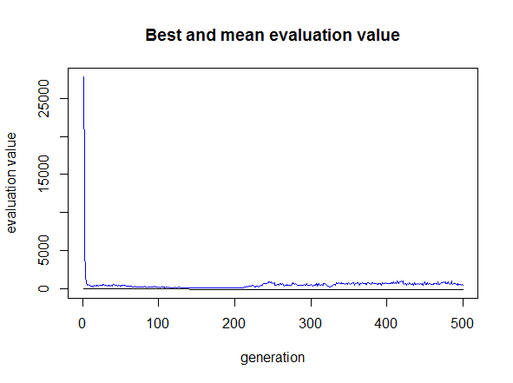
What does the GA do?
For the number of players in dataset it creates a binary chromosome representation
  1 = Player is in line up
  0 = Player is out
Each chromosome is evaluated using the performance function
  If chromosome (line-up) meets all the requirements of the function, the fantasy score for the team is used to as a negative score
  Optimize for minimal score

Slide 6
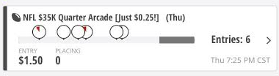

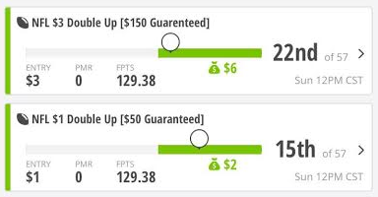
Results
ESPN proved to be a poor data source for projected points
Best results came from combining NFL’s projected points with additional research

Slide 7
Conclusions – Future Enhancements
Genetic Algorithms work perfectly for this task…
  Customization of fitness function allows flexibility
…but they can only do so much
  Can optimize for salary and points
  Mystery is still which players will be successful on a given week
Enhancements – focus on data collection
  Create my own projected points
  Weighted average of different sources

Slide 8
Thank you – Questions?

